Slide 1
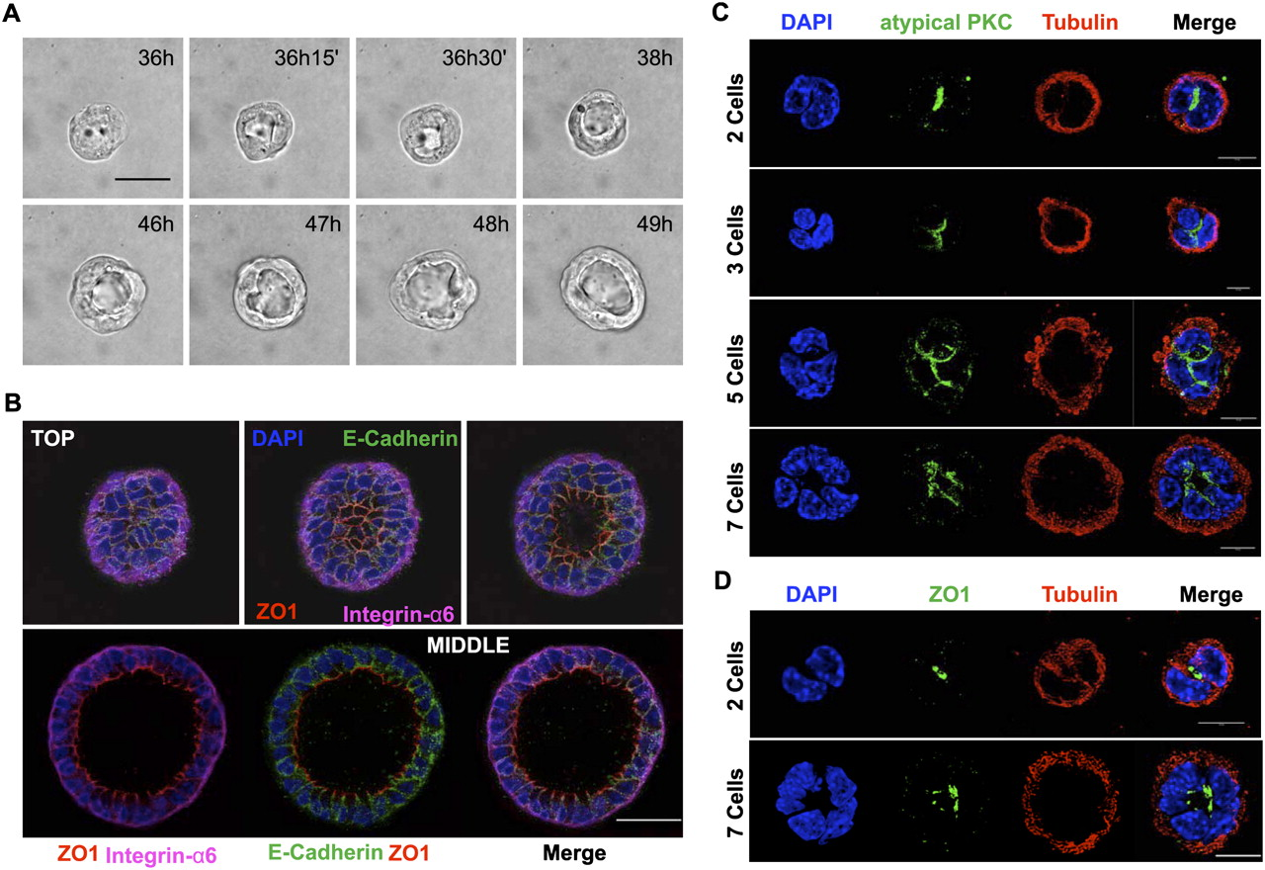

Nontransgenic primary mammary cells grown in 3D cultures develop acini composed of polarized epithelial cells.
Jechlinger M et al. Genes Dev. 2009;23:1677-1688
©2009 by Cold Spring Harbor Laboratory Press
Notes:
Nontransgenic primary mammary cells grown in 3D cultures develop acini composed of polarized epithelial cells. (A) Pictures taken every 15 min using a bright-field microscope show a typical colony of mammary cells derived from nontransgenic mice develop into an acinus at the indicated time points. Bar, 10 μm. (B) Confocal microscopy demonstrates epithelial cell polarity in a single large acinus. Each panel projects 25 subsequent confocal images (covering 5 μm). (Top panels) Three adjacent sections from the top of the acinus (15 μm total). (Bottom panels) Five-micron projection through the middle of the acinus. (Blue) DAPI stain; (green) E-Cadherin (adherent junctions, lateral); (red) ZO1 (tight junctions, apical); (magenta) Integrin α6 (basolateral). Bar, 30 μm. (C) Confocal microscopy localizes the apical marker aPKC to the peri-luminal region. The figure shows projection of 20 confocal image layers (each covering 4 μm in total). (Top panels) Two-cell stage. (Second row) Three-cell stage. (Third row) Five-cell stage. (Bottom row) Seven-cell stage. (Blue) DAPI stain; (green) aPKC; (red) β-tubulin. Bar, 10 μm. (D) Confocal microscopy after staining with anti-ZO1 antiserum identifies the tight junction protein ZO1 at the center of the spheres. Each panel shows 20 confocal images (covering 4 μm total) through the middle of an acinus. (Top panels) Two-cell stage. (Bottom panels) Eight-cell stage. (Blue) DAPI stain; (green) ZO1; (red) β-tubulin. Bar, 10 μm.

